Slide 1
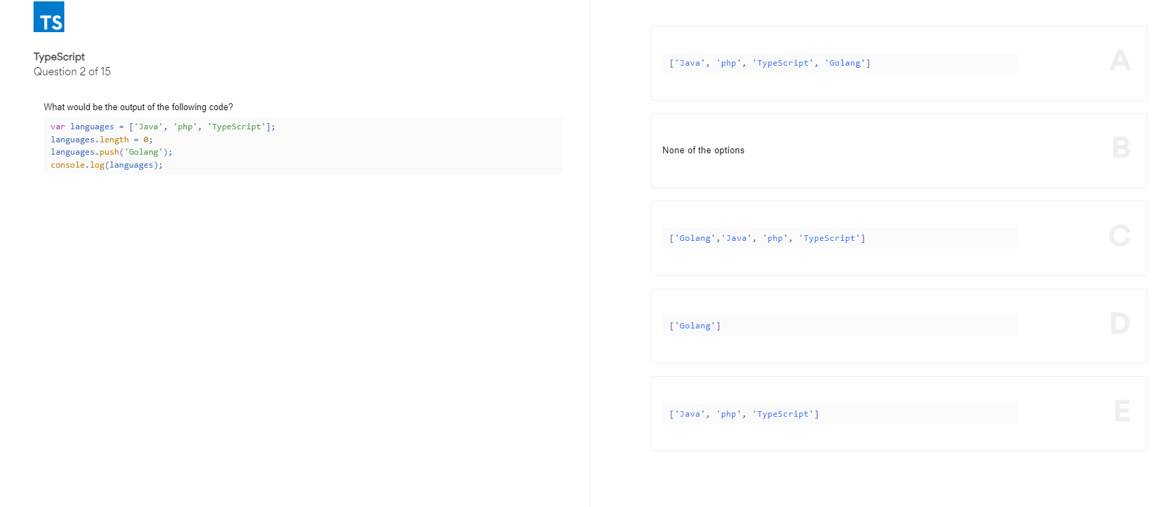
D

Slide 2
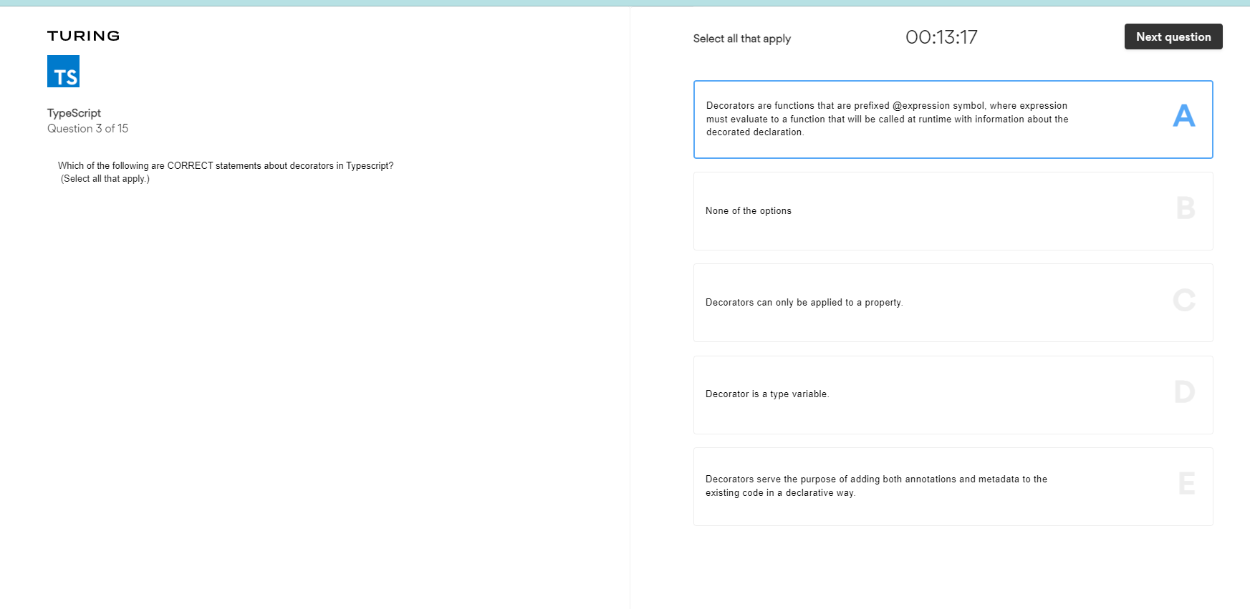

Slide 3
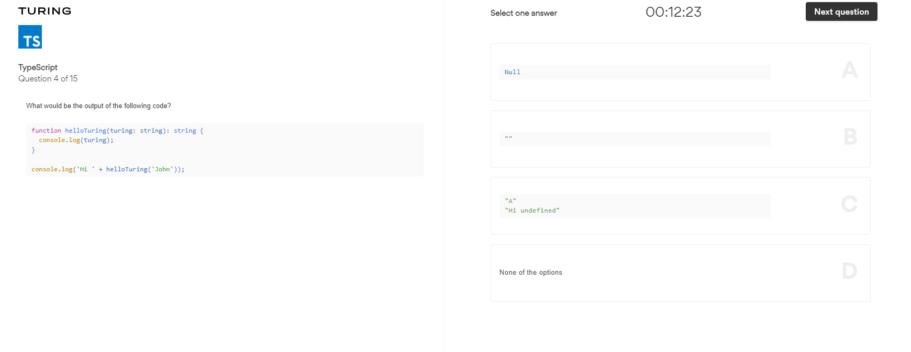
D

Slide 4
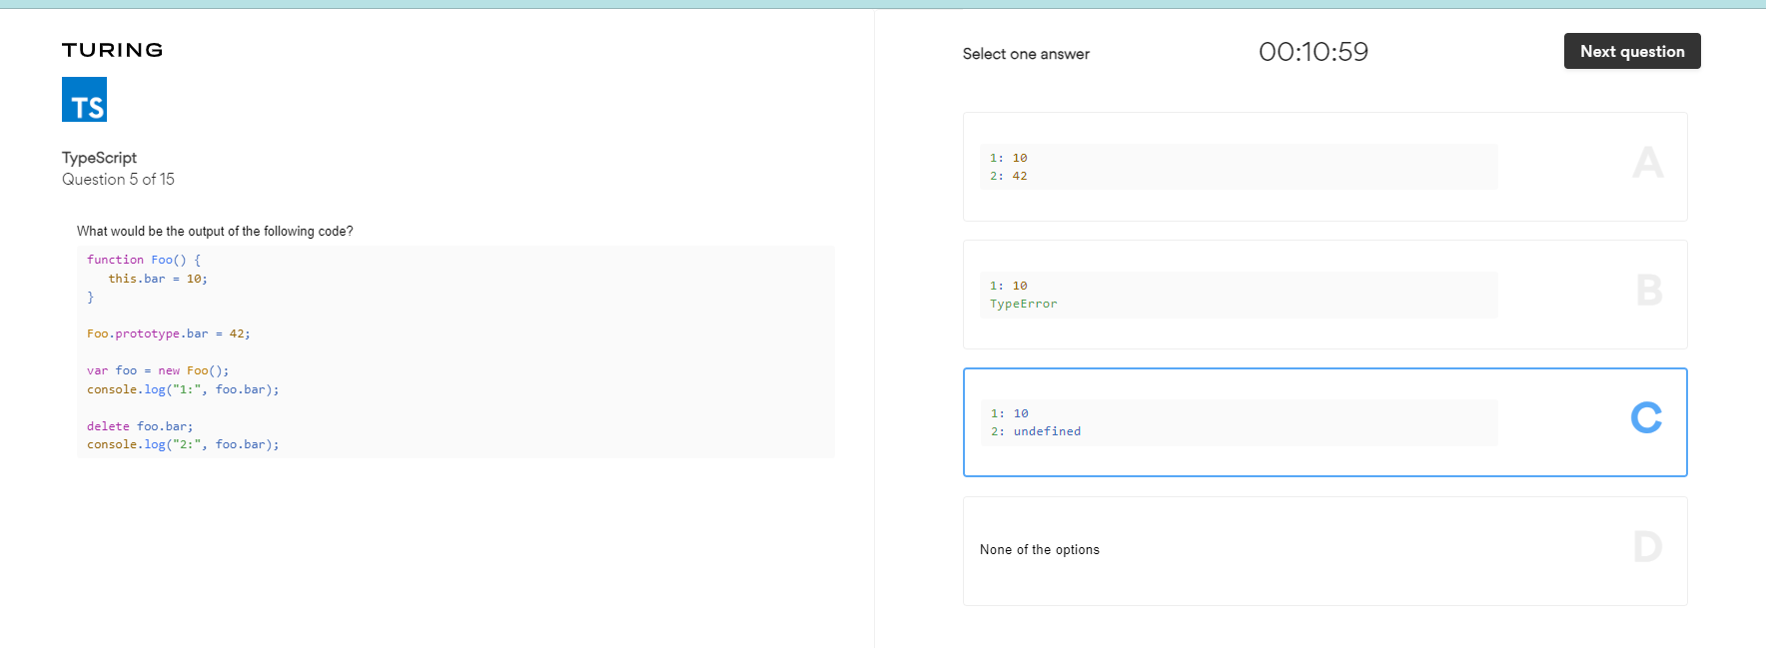
SHOULD BE A

Slide 5
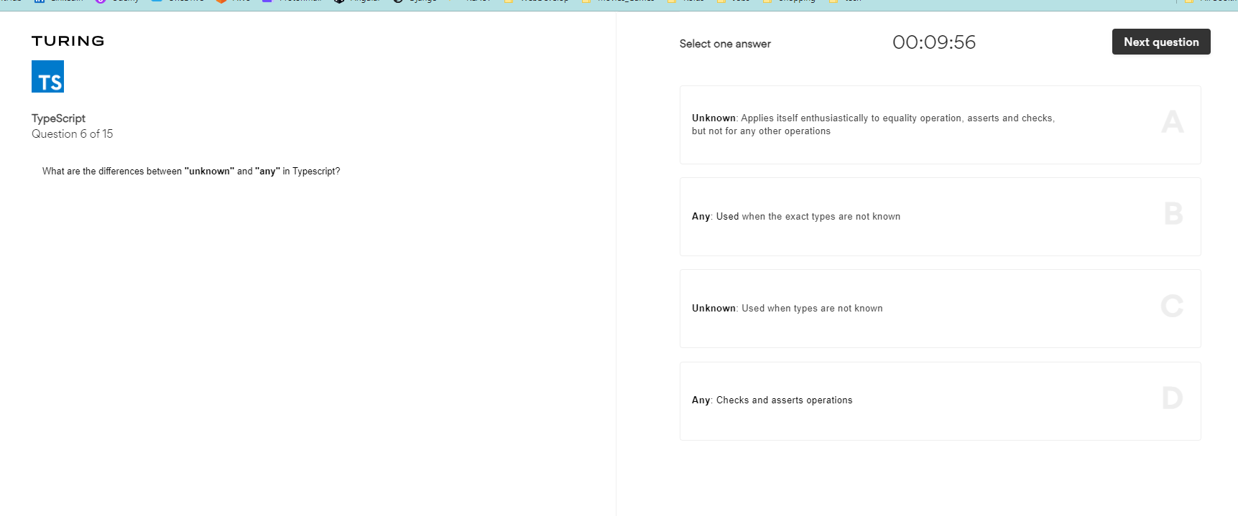
B

Slide 6
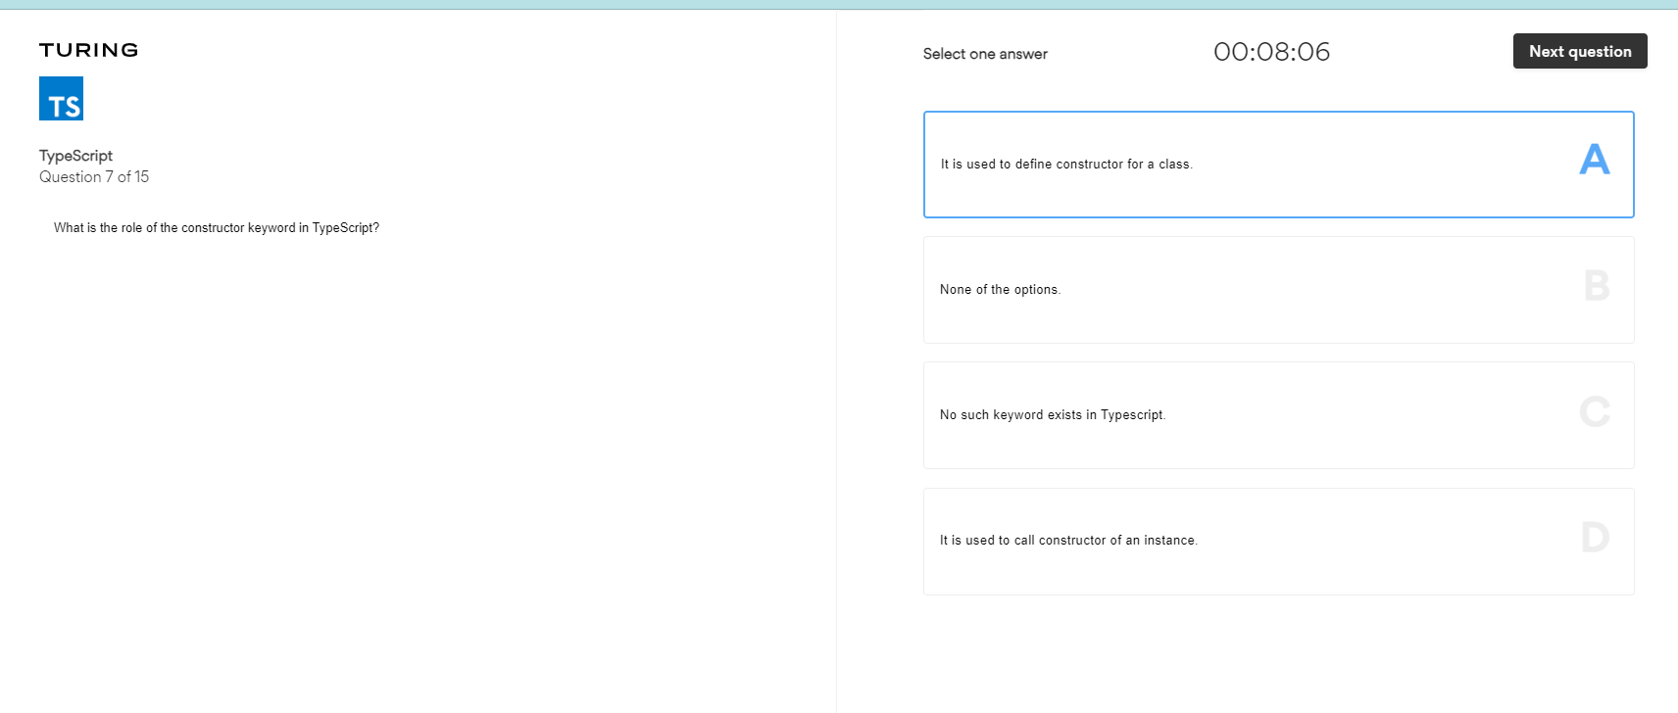

Slide 7
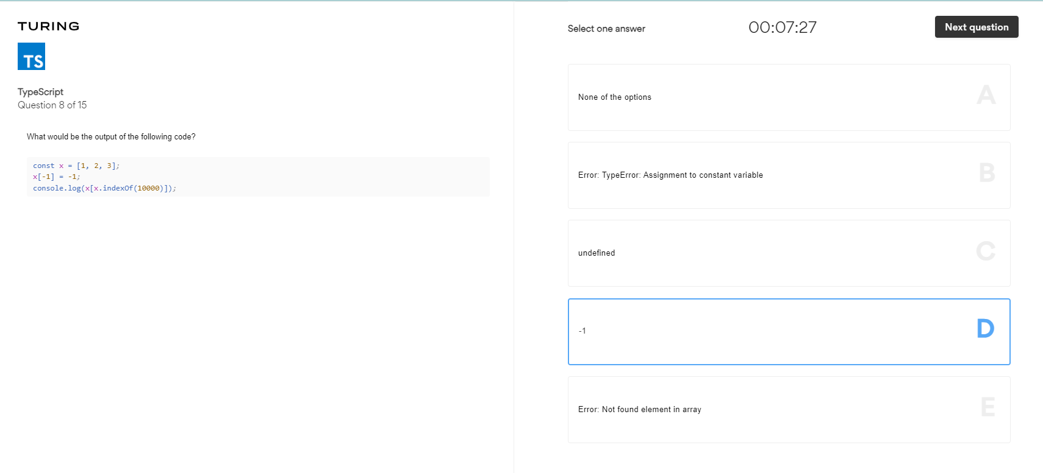

Slide 8
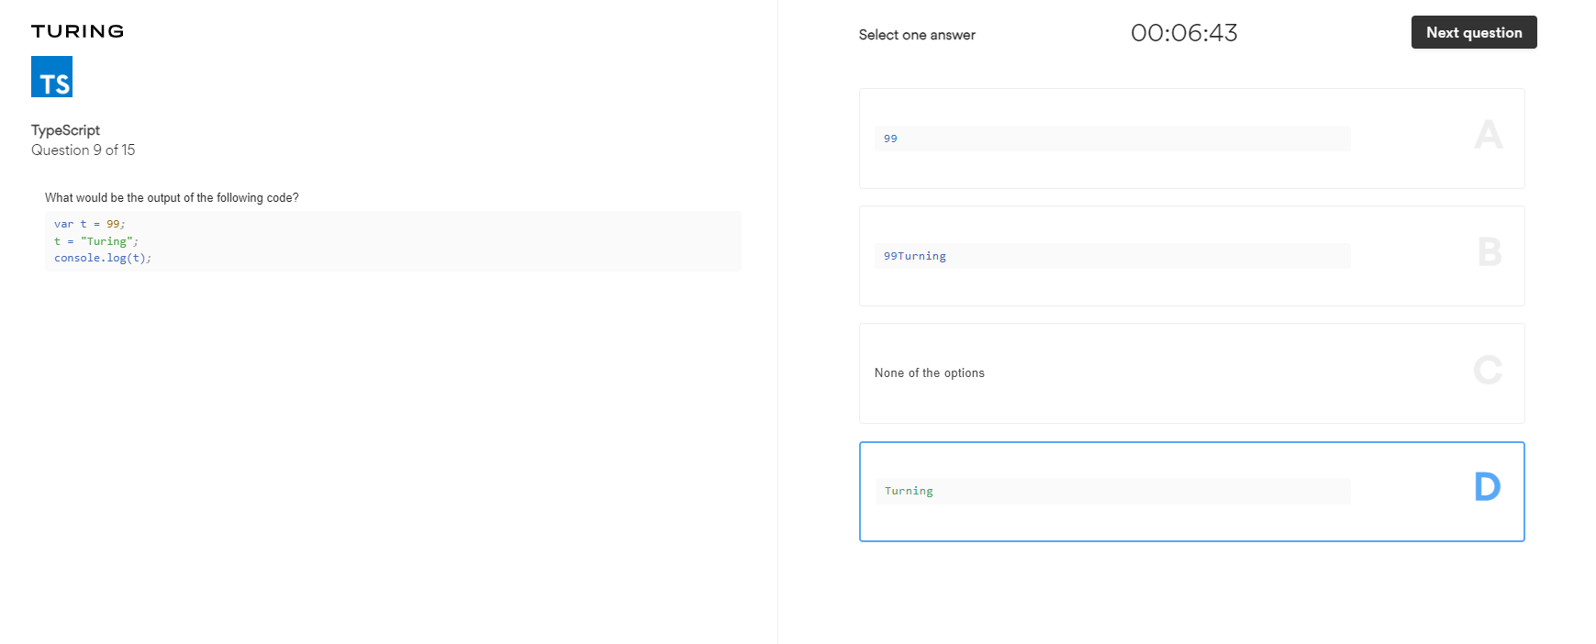

Slide 9
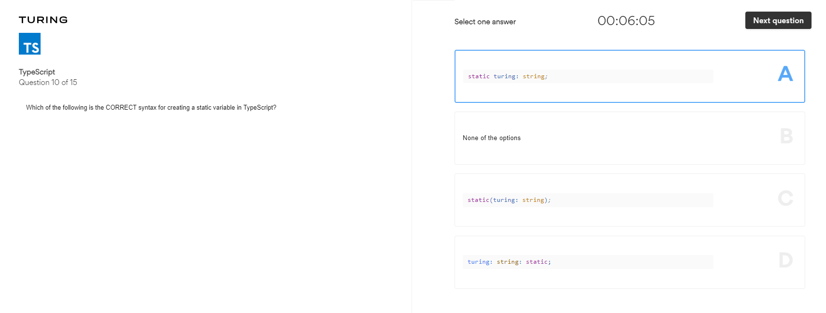

Slide 10
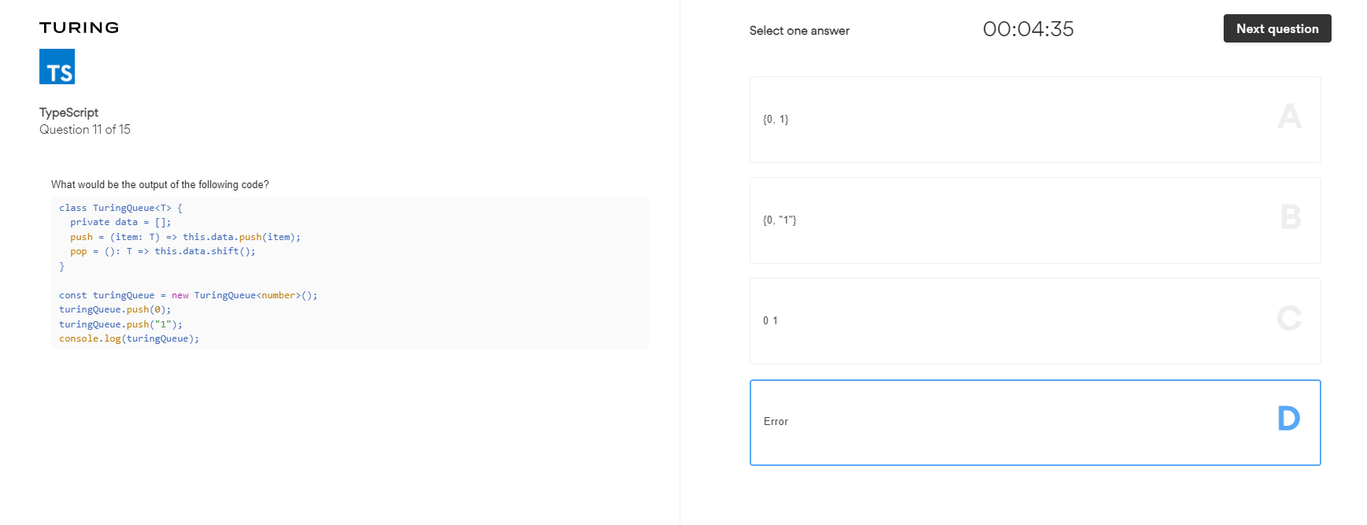

Slide 11
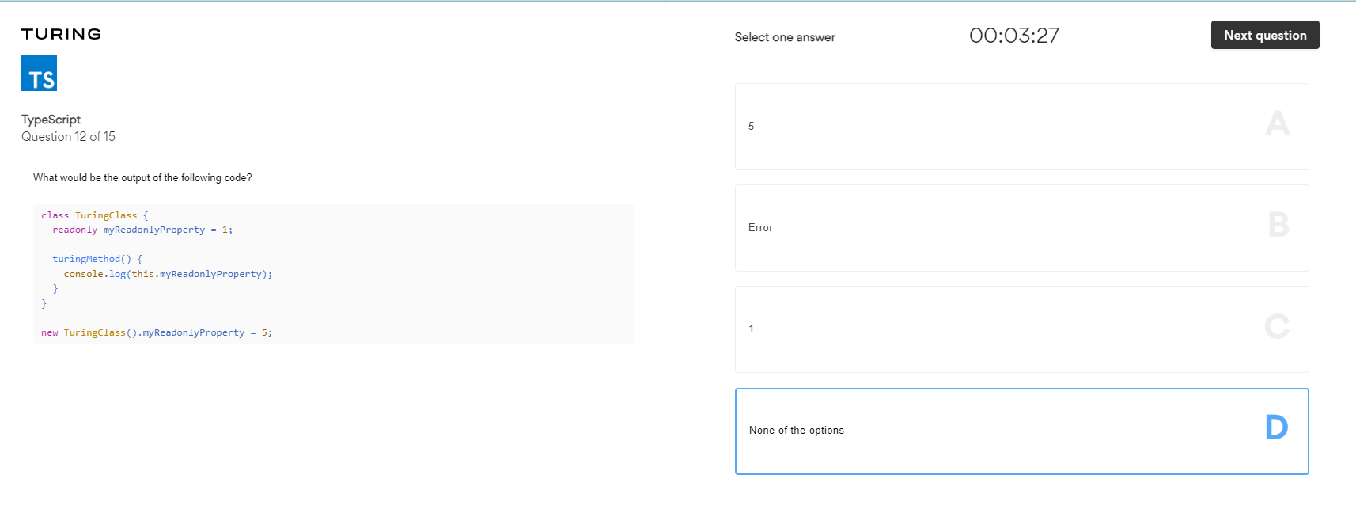

Slide 12
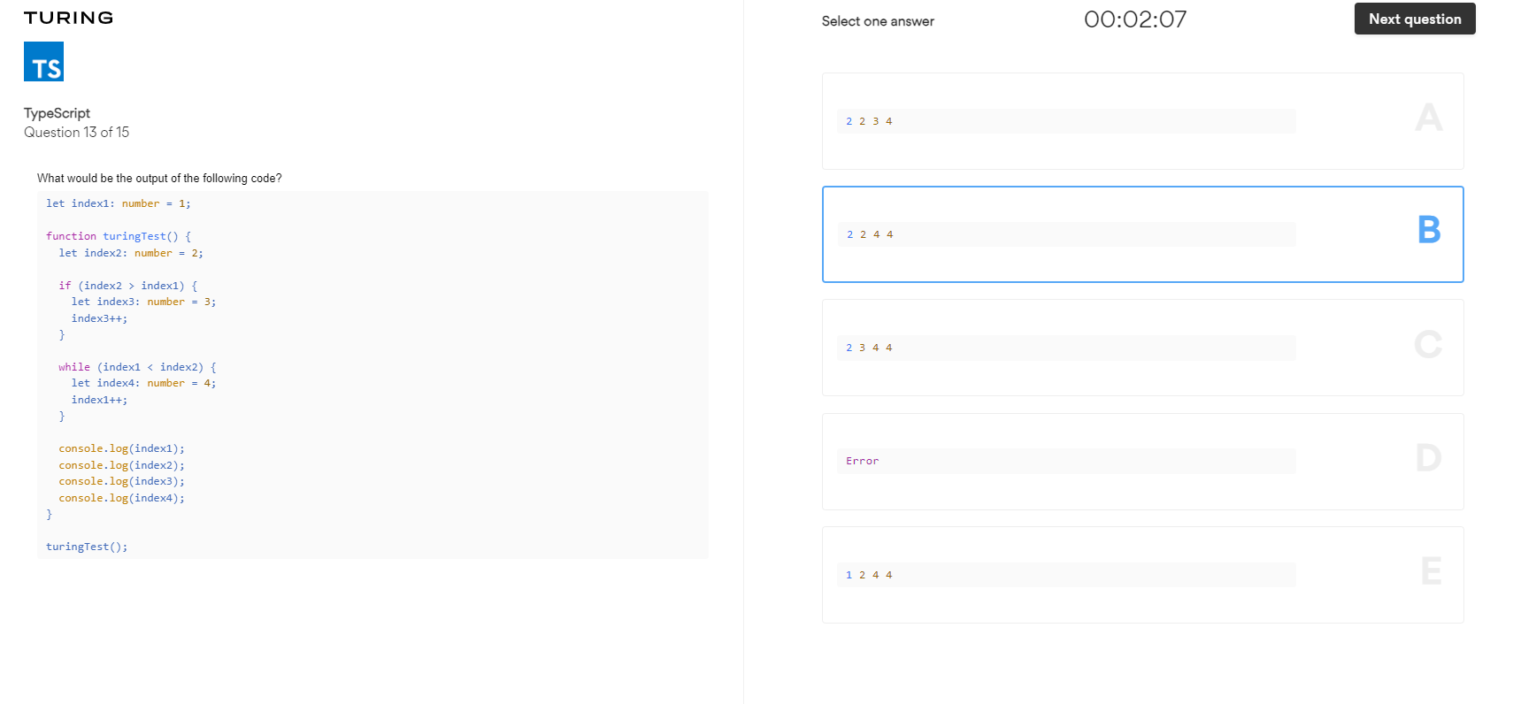

Slide 13
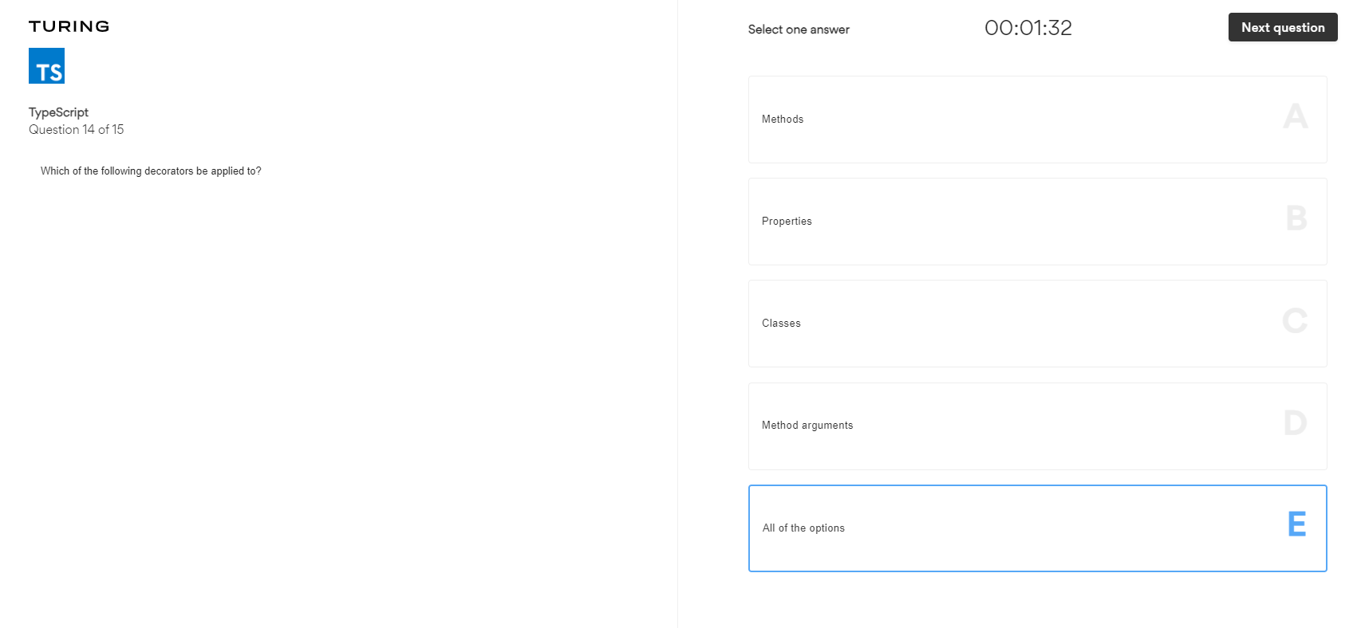

Slide 14
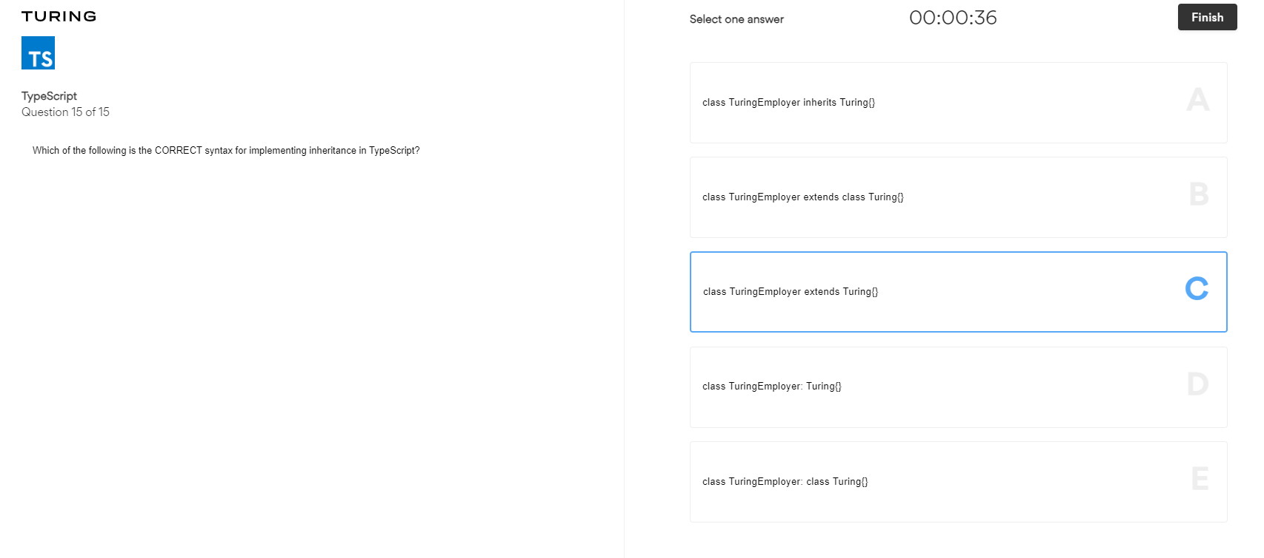

Slide 15
function Foo() {
this.bar = 10
}
Foo.prototype.bar = 42
var f1 = new Foo()
console.log(f1)
console.log(f1.bar)
delete f1.bar
console.log(f1)
console.log(f1.bar)
const x = [1, 2, 3]
x.length = 0
x[2] = 300
console.log(x)
console.log(x[0])
console.log(typeof x[0])
class Turing<T> {
private data = []
push = (item: T) => this.data.push(item)
pop = () => this.data.shift()
}
const t1 = new Turing<number>()
t1.push(0)
t1.push("1")
console.log(t1)
class Queue {
readonly pro = 1
print() {
console.log(this.pro)
}
}
new Queue().pro = 5
//q1.pro = 5
//q1.print()

